Slide 1
Check & Connect
Te Hononga
Overview
Notes:
NOTES FOR SESSION PRESENTER
This presentation is for a school leader or Ministry of Education representative to use when giving a brief overview of Check & Connect: Te Hononga to an audience (e.g., the staff in a school that’s about to adopt the initiative).
The presentation ends with a brief video on Check & Connect. There are eight such videos available at www.xxxx. Depending on the time available, you may wish to view these and select another one or two to incorporate in the presentation.
The video requires an internet/wi-fi connection with good bandwidth to play. If this isn’t available, you’ll need to download the video ahead of time from www.xxxx.
You may want to add one or two additional slides for opening and closing the presentation in a way that is appropriate for you and participants.

Slide 2
Purpose of this session
Today you will learn about:
what Check & Connect: Te Hononga is and who it’s for
how it works, particularly the key role of kaihoe (mentor)
your role in supporting the initiative and making it work
the kaiurungi (coordinator) role, and who will be fulfilling that role in our school.
Notes:
ONCE FINALISED, CHANGE FOOTER TO CORRECT PUNCTUATION FOR ‘CHECK & CONNECT: TE HONONGA’
Explain
The purpose of this session is for you to learn about Check & Connect: Te Hononga – a two-year mentoring initiative [add “that we’re introducing to our school” if appropriate].
You will learn about:
what Check & Connect: Te Hononga is and who it’s for
how it works, particularly the key role of kaihoe (mentor)
your role in supporting the initiative and making it work
the kaiurungi (coordinator) role and who’ll be fulfilling that role in our school.

Slide 3
Who is Check & Connect: Te Hononga for?
Students considered for Check & Connect will be disengaging from learning and be at risk of dropping out.
(Check & Connect: Te Hononga manual, p. 26)
Notes:
Explain
Check & Connect: Te Hononga is intended for ākonga who show signs of disengaging from education and are at risk of non-attendance. There is extensive evidence to show that disengagement and non-attendance have negative consequences that have a lifelong negative impact on ākonga and whānau. We know that some of our ākonga are in that situation, and we want to turn it around.
If you are presenting to a school staff, and the school is a PB4L School-Wide school, then explain that:
Check & Connect: Te Hononga sits within the suite of PB4L initiatives
it is a Tier 2 initiative, for a limited number of ākonga who require additional support
the school’s PB4L Team will help ensure the initiative works alongside and aligns with PB4L School-Wide.

Slide 4
Why have we chosen to adopt Check & Connect: Te Hononga?
There is improvement in students’ belief in the importance of school learning for their future, in taking school seriously, caring that they do their best work, liking to do their homework properly, ability to concentrate on what they do in class, and enjoyment of learning.
(NZCER 2016 evaluation, p. 21)
Notes:
[SLIDE 1 OF 2]
Explain that there is very good evidence from here in Aotearoa and from other countries for Check & Connect: Te Hononga and its benefits for ākonga at risk of disengaging from school. The initiative has been used extensively in the USA and many other countries, with research studies consistently showing evidence of improved enrolment, attendance, engagement with learning, and outcomes for its target students.

Slide 5
Why have we chosen to adopt Check & Connect: Te Hononga?
[I liked] being able to open up to someone who I trust. Being able to have someone understand what I go through with teachers. …
I think the things that worked best for me were seeing someone that I could talk to every week and her checking on my progress and helping me through things I found hard. And she motivated me all the time.
(NZCER 2016 evaluation, p. 41)
Notes:
[SLIDE 2 OF 2]
If you wish, draw on the below as well:
As well as citing a wealth of empirical research, the Check & Connect University of Minnesota manual identifies four key lessons learned from twenty years of implementation and research:
the power, value, and importance of personalised interventions … for engaging ākonga who are disengaged or at risk of non-attendance
relationships are essential for students’ behaviour change, commitment to learning, and academic progress in school
leadership provided by a coordinator or designated initiative leader is essential to maintain fidelity of implementation
engaging ākonga academically, behaviourally, cognitively, and affectively is the key to success.
Christenson et al. (2012), pp. ii–iii

Slide 6
How does Check & Connect: Te Hononga work?
A two-year, contextualised initiative
Check: Kaihoe (mentors) systematically check on attendance, achievement, and pastoral data to support problem solving.
Connect: Kaihoe connect with ākonga, providing personalised, timely responses to help solve problems, build skills, and enhance their competence.
Hononga: union, connection, relationship, or bond.
Notes:
Explain
Mentors meet with ākonga over a period of two years, usually in school but taking account of what is happening for ākonga at home and in the community. They report on progress for ākonga to whānau and the school. The principal and kaiurungi report to the board on progress within the initiative as a whole.
Check & Connect: Te Hononga involves closely monitoring ākonga for signs of disengagement and identifying protective factors and “alterable” factors that can be influenced to make disengagement less likely.
The ‘Check’ in Check & Connect: Te Hononga refers to the process where mentors – kaihoe – systematically monitor attendance, achievement, and pastoral data to support problem solving.
‘Connect’ refers to the way kaihoe connect with ākonga to provide personalised, timely responses intended to help them solve problems, build skills, and enhance their competence.
Prominent educational researchers Sonja and Angus Macfarlane helped develop the manual that guides implementation. They gifted the name ‘Te Hononga’ to the initiative. Te Hononga means “linking, connecting, bringing together”. It’s a name that emphasises the long-term commitment to relationships that is at the heart of the initiative.

Slide 7
Ngā tūranga o Te Hononga | Check & Connect roles
Everyone involved in the initiative will work towards the same goal of engagement and success for the student. Everyone needs to understand that this partnership is resolutely learning focused.
(Check & Connect manual, p. 23)
Ākonga, whānau, and iwi
Tumuaki
Principal
Kaiurungi
Coordinator
Kaimahi
Staff
Kaihoe
Mentor
Kaiārahi
Supervisor
Notes:
Explain that the success of Check & Connect: Te Hononga depends upon the creation of a system in which people who hold different roles work together to make school a place where rangatahi feel they belong, are valued, and want to participate.
Present this brief overview:
Tumuaki | Principal: responsible for information sharing, advocacy, resourcing, relationship-building
Kaiurungi | Coordinator: oversees implementation and administration and strives to maintain its fidelity
Kaihoe | Mentor: the key role in the initiative, works collaboratively, for at least two years, with the ākonga, their whānau, and their teachers to implement strategies that support school engagement and educational success
Kaiārahi | Supervisor: provides ongoing support and guidance for kaihoe
Kaimahi | School staff: share information and ideas; support kaihoe in their work, including through their willingness to try new, different approaches that might support a student’s engagement and sense of belonging
Ākonga and their whānau are at the heart of Check & Connect: Te Hononga; kaihoe | mentors build relationships and share progress with whānau.
Emphasise: For all of us, our children hold our past and our future. Partnership with whānau is critical to making Check & Connect: Te Hononga work.
Tell your audience who your school’s kaiurungi will be. Emphasise that while they oversee the system, everybody is expected to play their part.
If they’ve been appointed, tell your audience who the kaihoe will be and, if possible, include photos in the presentation. If they’re available, either at this point or a later date, welcome them and introduce them to the audience.

Slide 8
Kaiako | Teacher role
Communicate: Share information and ideas with the kaihoe.
Engage: Try new approaches that may support ākonga to feel engaged and that they belong.
Collaborate: Seek understanding of what the kaihoe is doing and how you can help.
Implement: Collaborate with the ākonga, their whānau, and their kaihoe to implement strategies that support school engagement and educational success.
Respond: Support learning goals that have been developed by ākonga, whānau, and kaihoe.
Notes:
Explain that:
kaihoe are a resource for ākonga and not for staff
kaihoe have a specific, clearly defined mentoring role
kaihoe only meet with ākonga once a week; in the classroom and around the school, it remains the task of kaimahi (especially kaiako) to implement strategies that support school engagement and educational success
kaiako need to be available on occasion to share information about ākonga progress and their interests and goals
all staff are expected to be supportive and to work collaboratively with kaihoe when asked.

Slide 9
You are important
Watch: Check & Connect - And it works
Notes:
Reinforce:
Check & Connect: Te Hononga does work to reengage ākonga in learning and improve their wellbeing.
Its success requires information sharing and collaboration between people from across the school, with whānau, and with community.
Check & Connect: Te Hononga has made a big difference already in many schools in Aotearoa. Here’s a video about that.

Slide 10
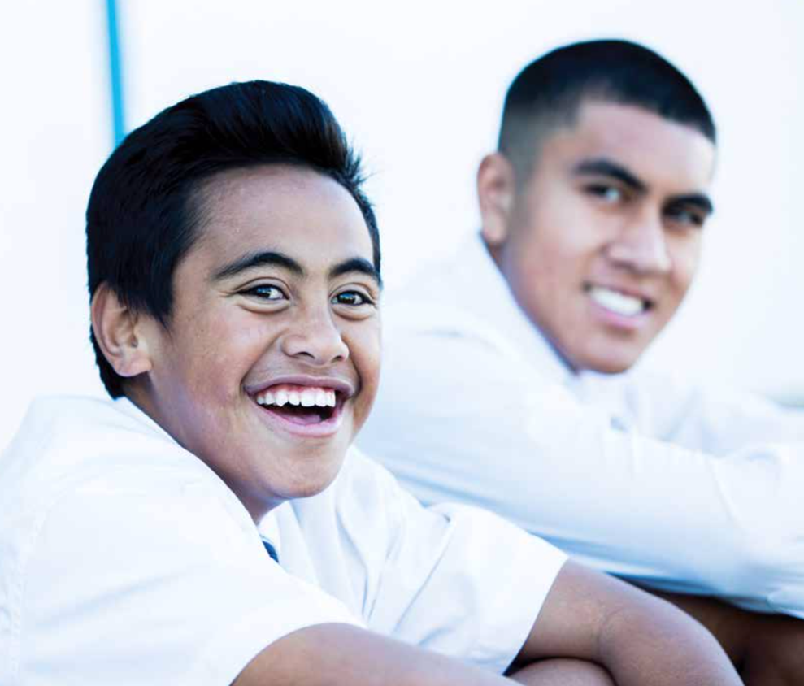
Kei roto i a koe tōu ake mana. Within each of us lies the seed of potential.
Notes:
Wrap up the session:
If you are presenting to a school staff, and the school is a PB4L–School Wide school, remind them again that Check & Connect: Te Hononga will operate within and align with PB4L–School Wide.
Thank participants for their attention and upcoming support for the initiative.

